Slide 1
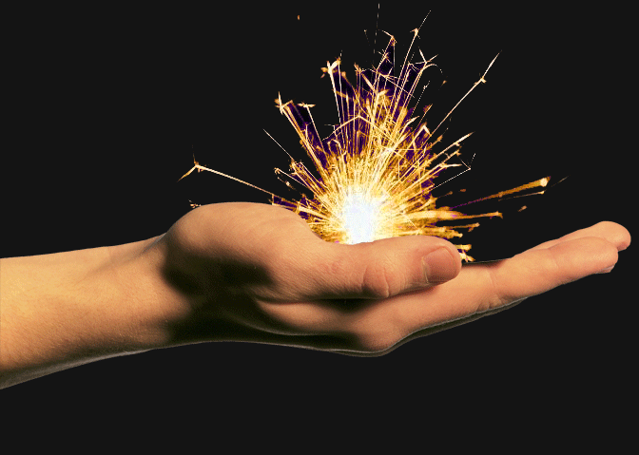
You need a SPARK to start a fire.

Slide 2
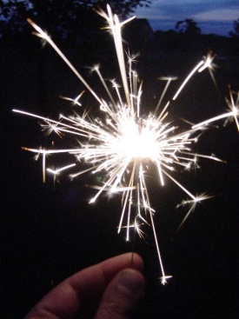
“Everyone has a spark-
whether you know
any of your sparks or not,
it’s definitely
worthwhile for you to
explore, identify, and
develop one, or two, or three!”

Slide 3
What kind of fire?
Will your SPARK make
your school better?
Will your SPARK help others
enjoy their SPARK?
Will your SPARK let you
enjoy life more?

Slide 4
What do you love to do?
What is your SPARK?
When are you really happy?
What are you passionate about?

Slide 5
For some it is…
nature
Sports
Reading
Healing
Art
Computers
Leadership
Helping People
Dance
Friendship
Music
Coaching

Slide 6
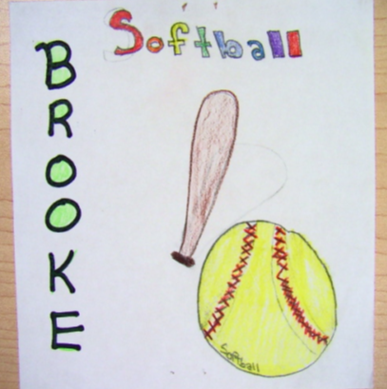
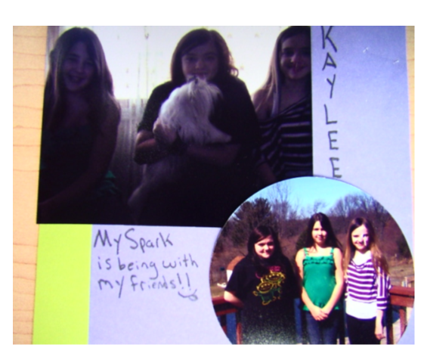
Examples!

Slide 7
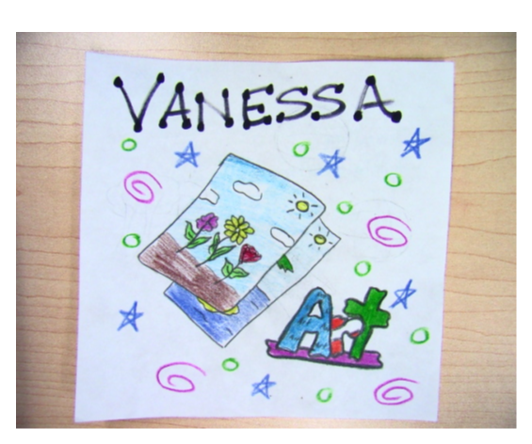
Another Example…

